Slide 1
Used car market
BACT
by Baby Drivers

Slide 2
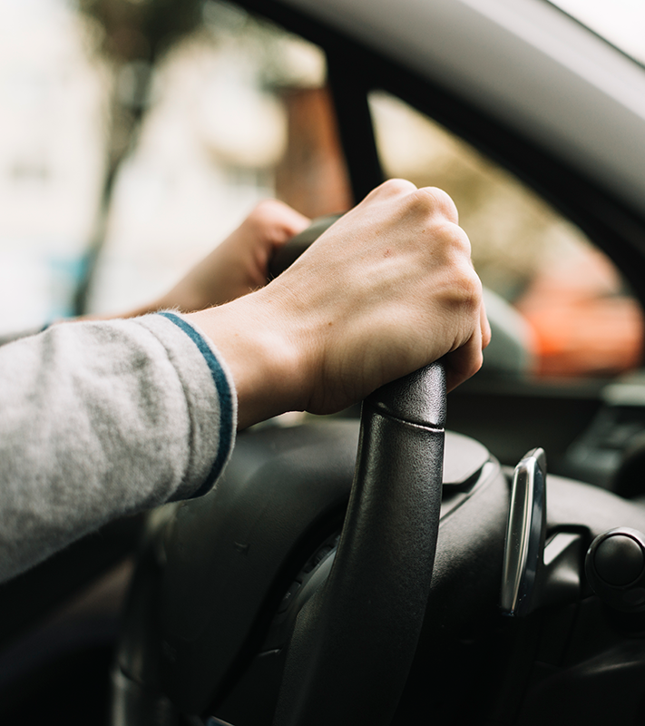
01
About Our Company

Slide 3
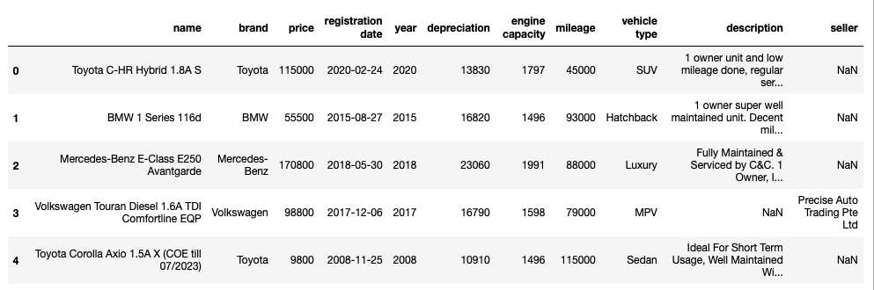
Our Dataset
Scraped the first 500 listings from sgcarmart.com

Slide 4
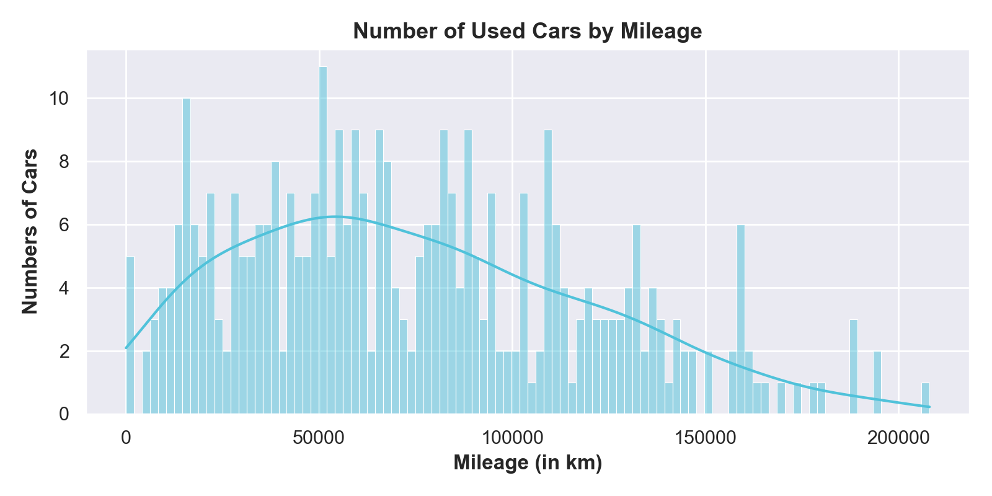
Distribution of Used Car’s Mileage
KDE plot peaks at around 50,000km
significantly lower > 120,000km
Strategy:
Offer higher mileage cars at a competitive price as a budget option
Notes:
KDE plot peaks around at around 50,000km and is significantly lower after 120dd,000km

Slide 5
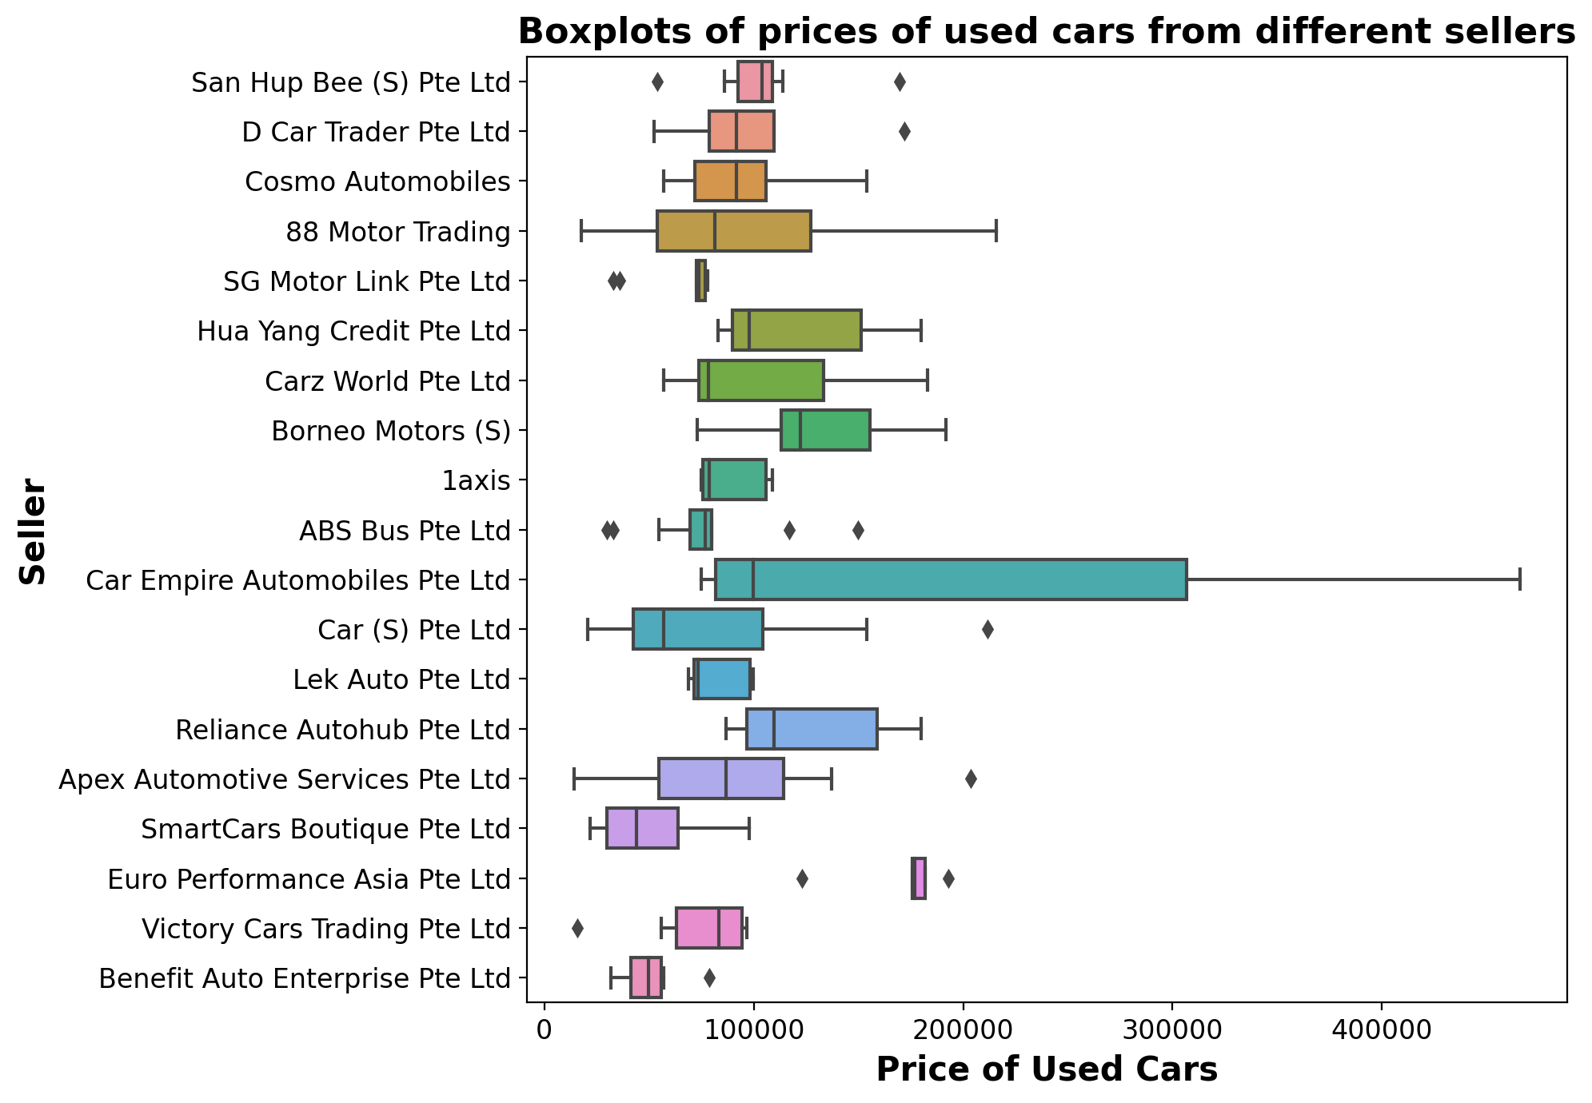
Price range
of sellers with at least 5 car listings
Higher-end
Car Empire Automobiles

Slide 6
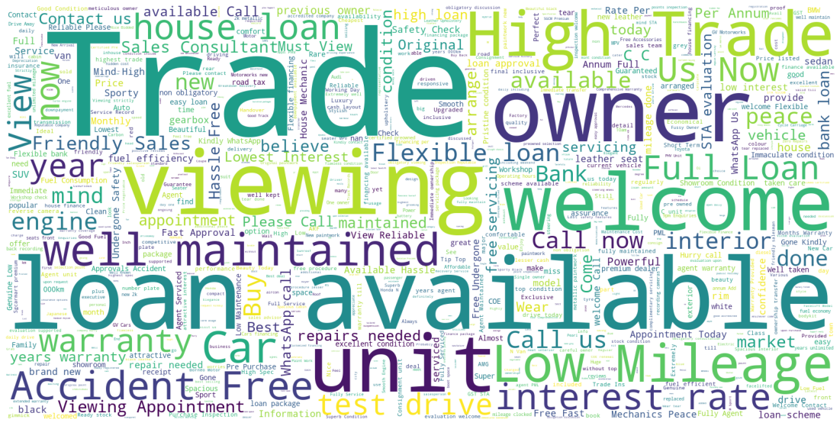
Popular Keywords
Trade in
Viewing
Number of owners
Loan (in-house? bank?)

Slide 7
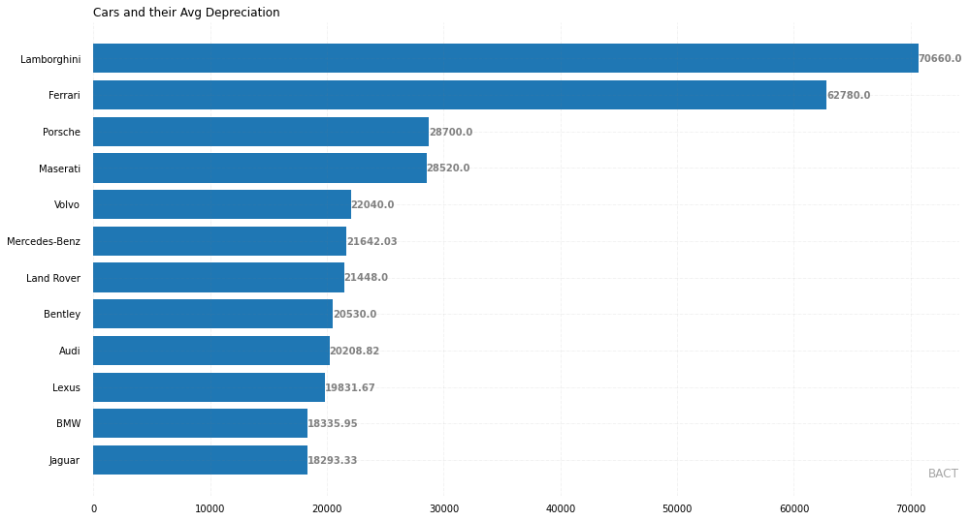
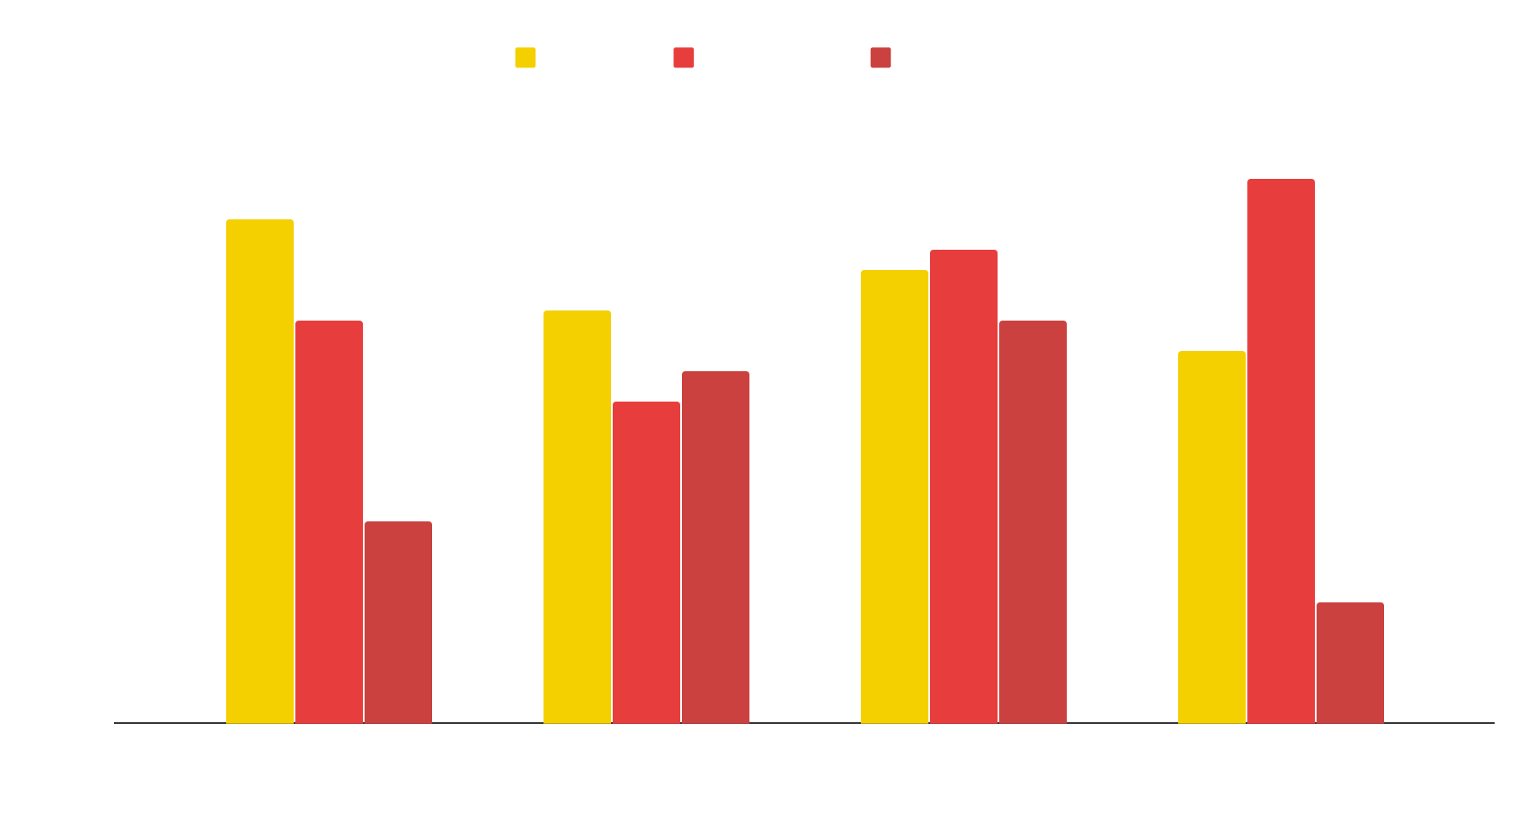
Average Depreciation
$70660
$7703
To modify this graph, click on it, follow the link, change the data and paste the resulting graph here
Highest (Lambo)
Lowest (Fiat)
$18,137
For the company to remain competitive against the biggest competitor SG Carmart, they would have to price the depreciation below the avg rate.
avg. depreciation

Slide 8
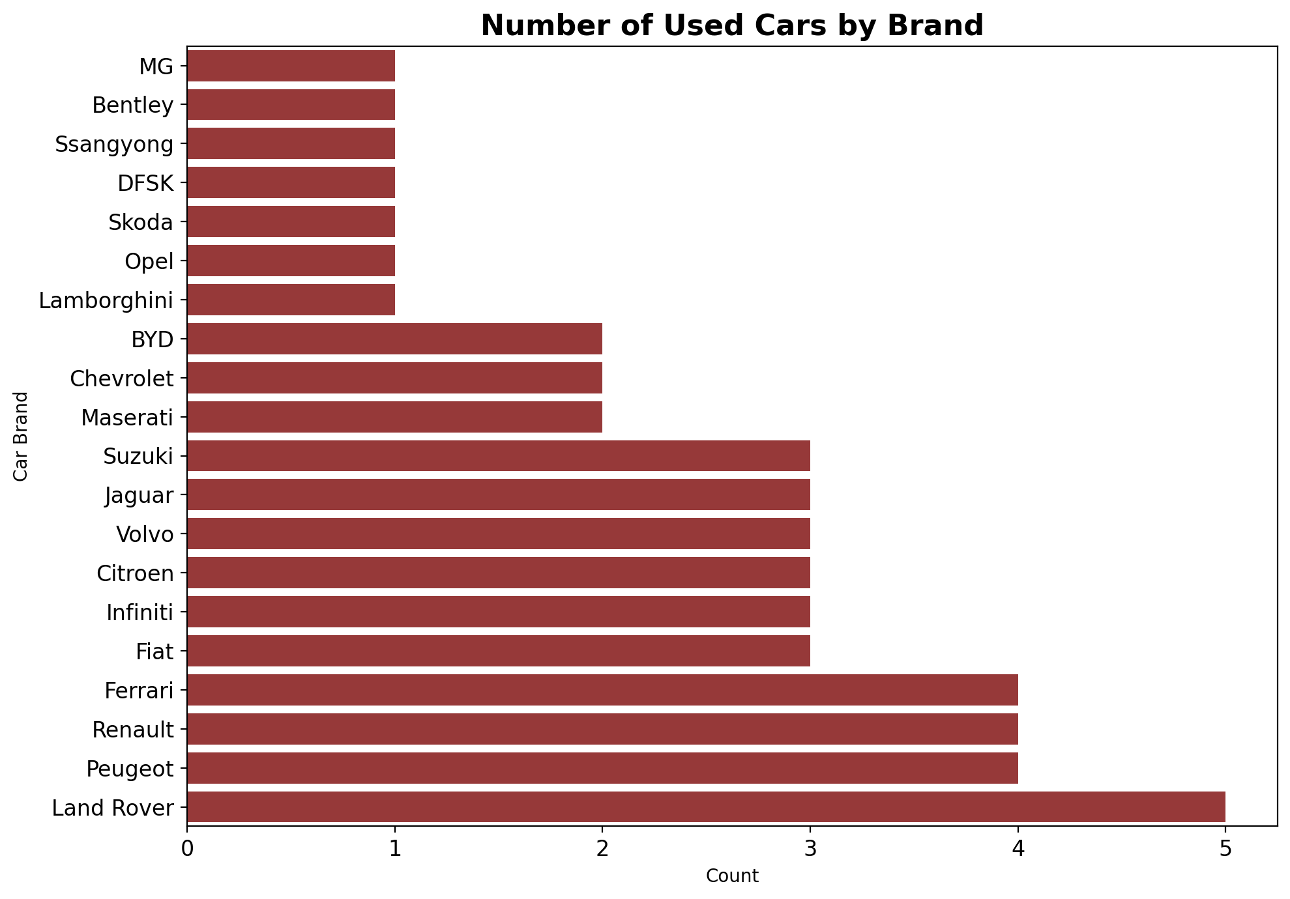
SG Carmart Vehicle Brands Available
500 Cars
33.6%
Our Sample Size
Percentage of Luxury Cars on Sale
SG Carmart has very few luxury vehicles as shown in the barchart. Hence, we can increase the number of these brands to attract more high values customers

Slide 9
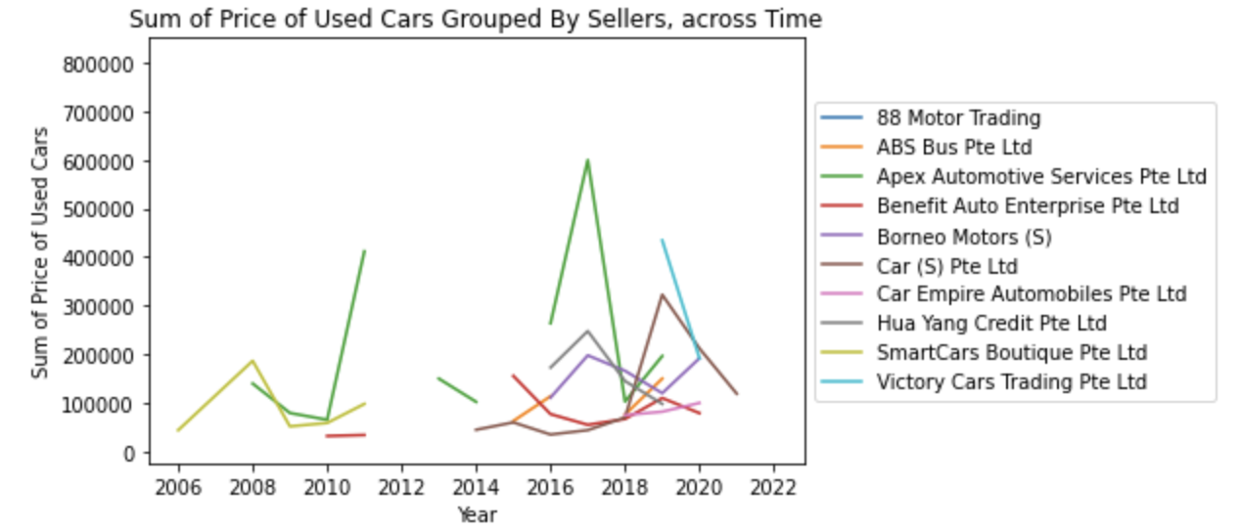
Sum of Price of Used Cars Across Time
Fluctuation in Prices
Across time and sellers
Anomaly
Highest price of listings of all times
$70660
$7703
Highest (Lambo)
Lowest (Fiat)
General Price of Listings
100 - 300k from 2016 onwards

Slide 10
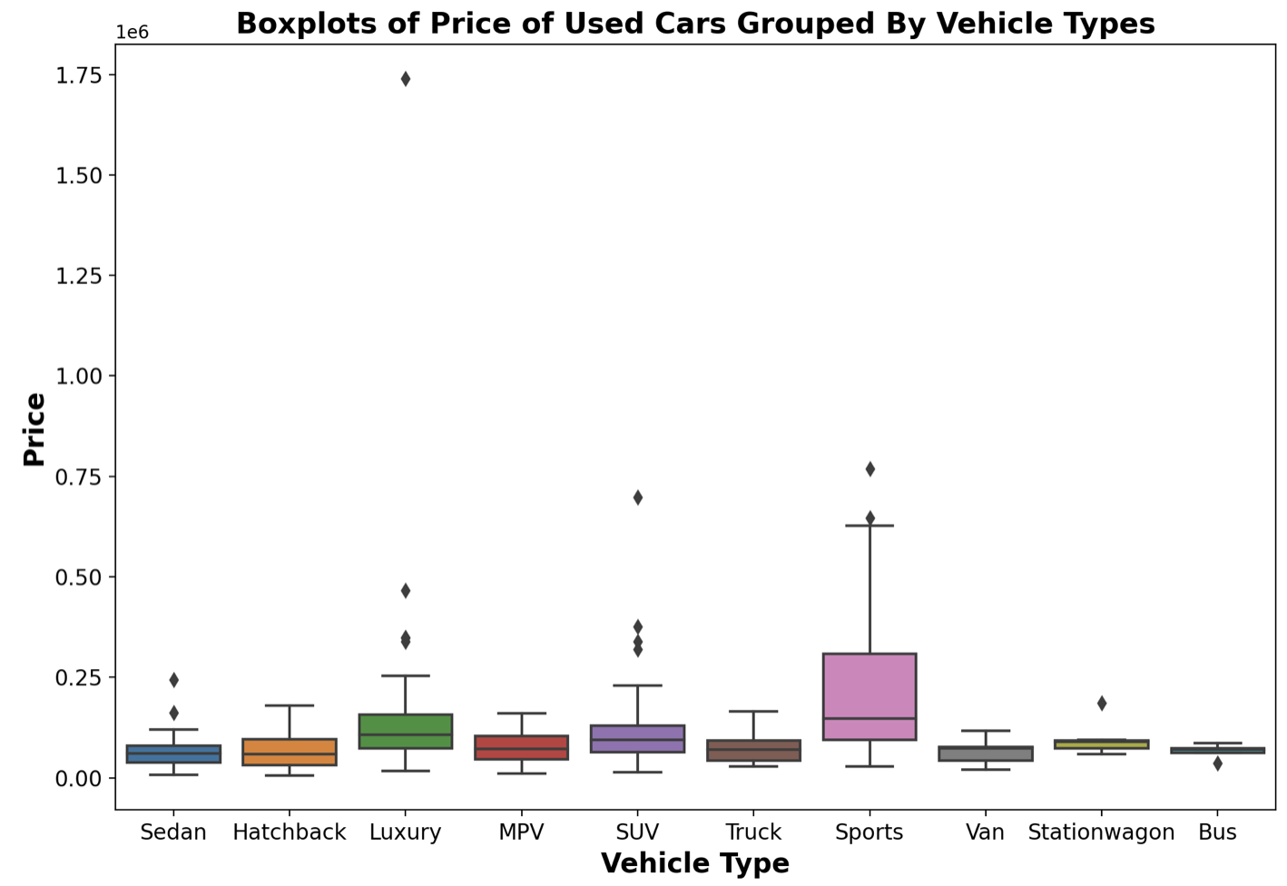
Boxplots of Price of Used Cars Grouped By Vehicle Types
Top 3 Median Price:
Sports > Luxury >SUV
Largest Spread of Price
$70660
$7703
Sports Cars
Highest (Lambo)
Lowest (Fiat)
Smallest Spread of Price
Bus & Stationwagon

Slide 11
THANKS

